Slide 1
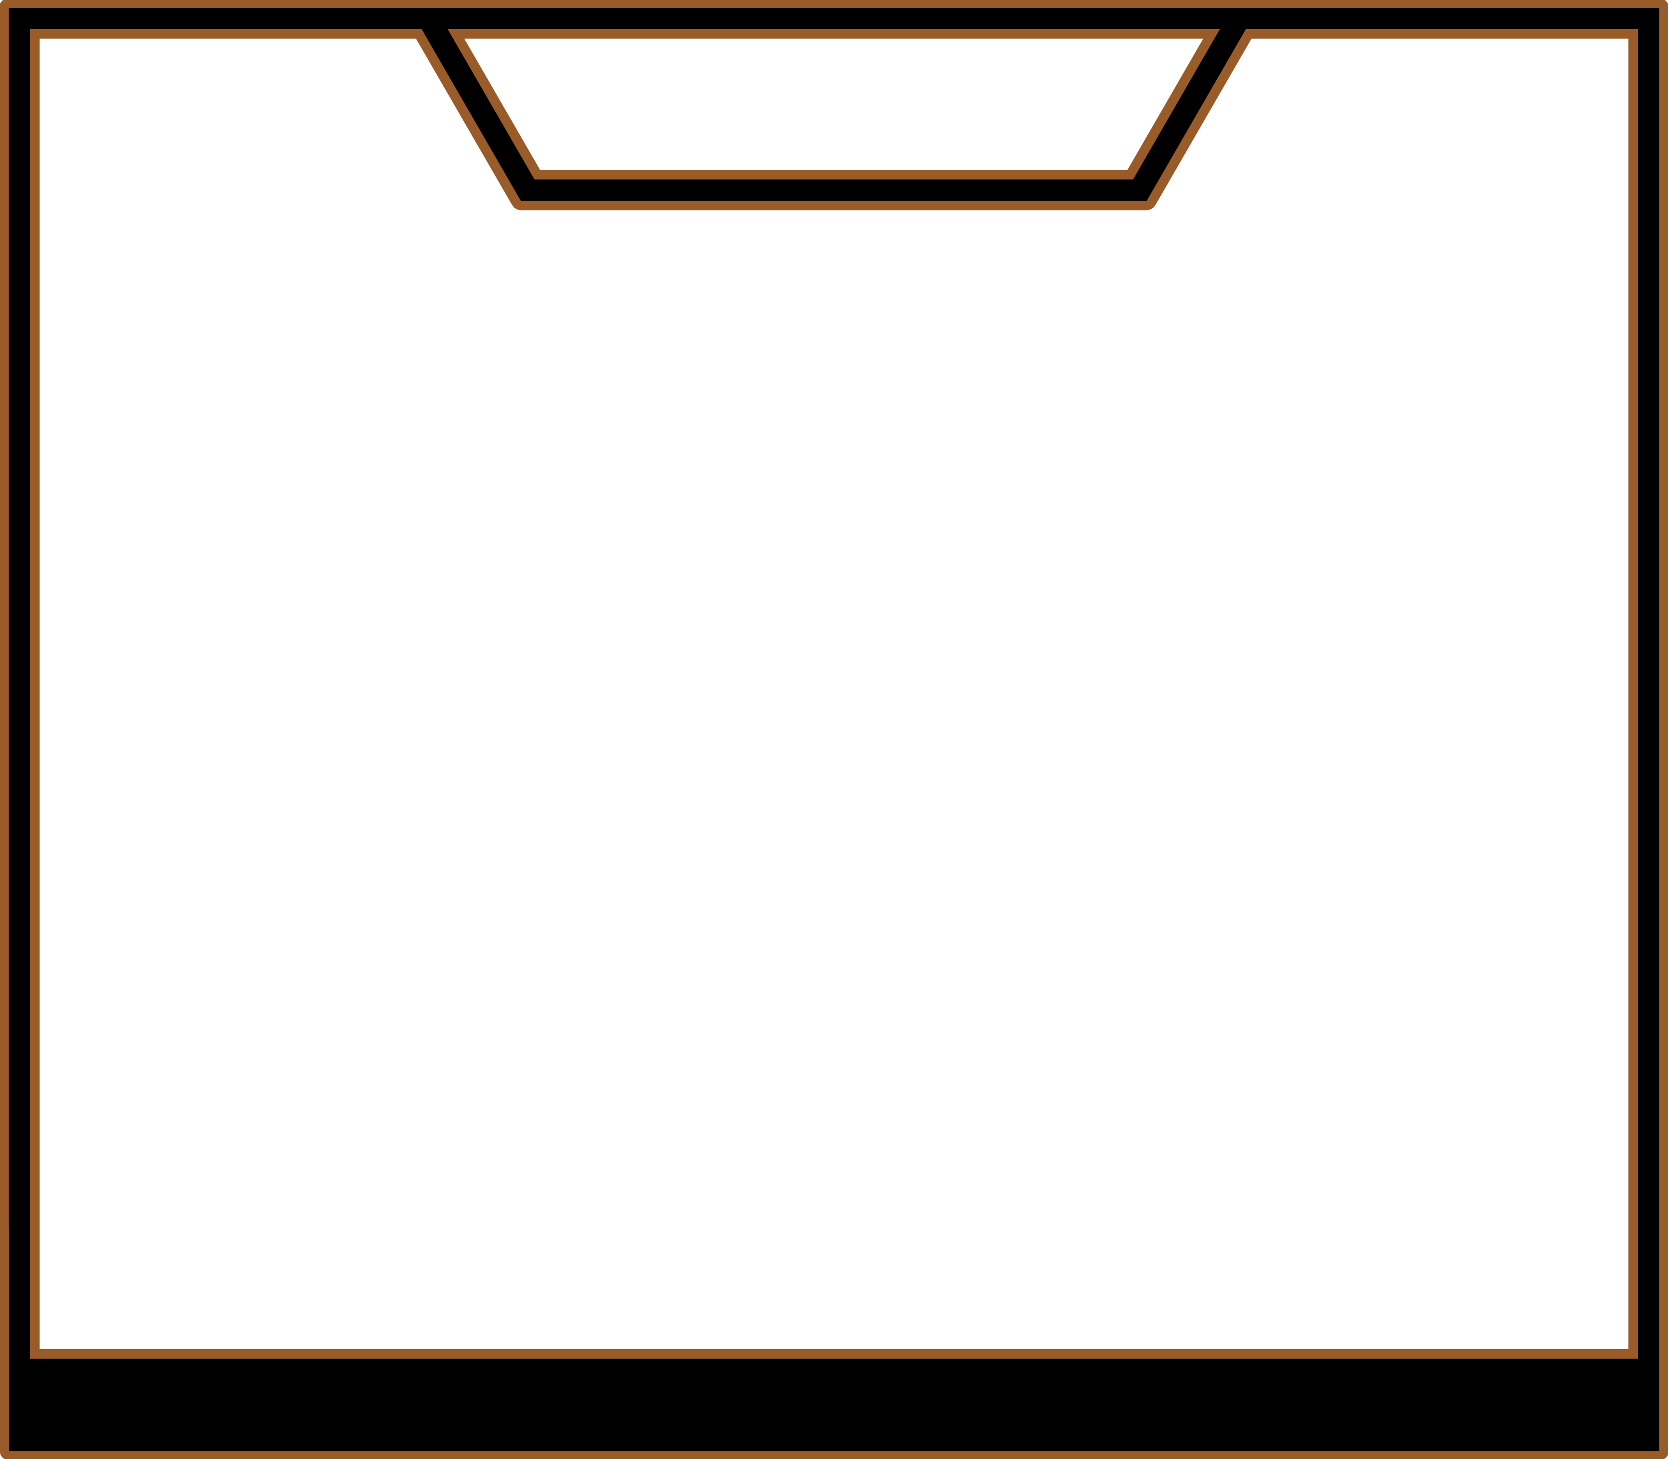
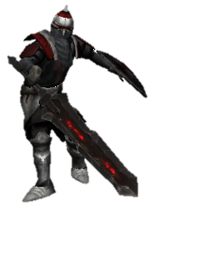
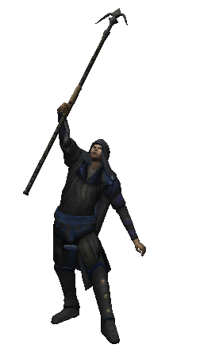
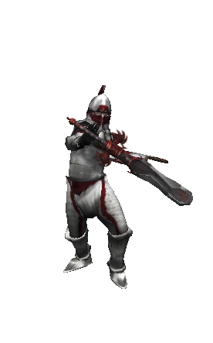
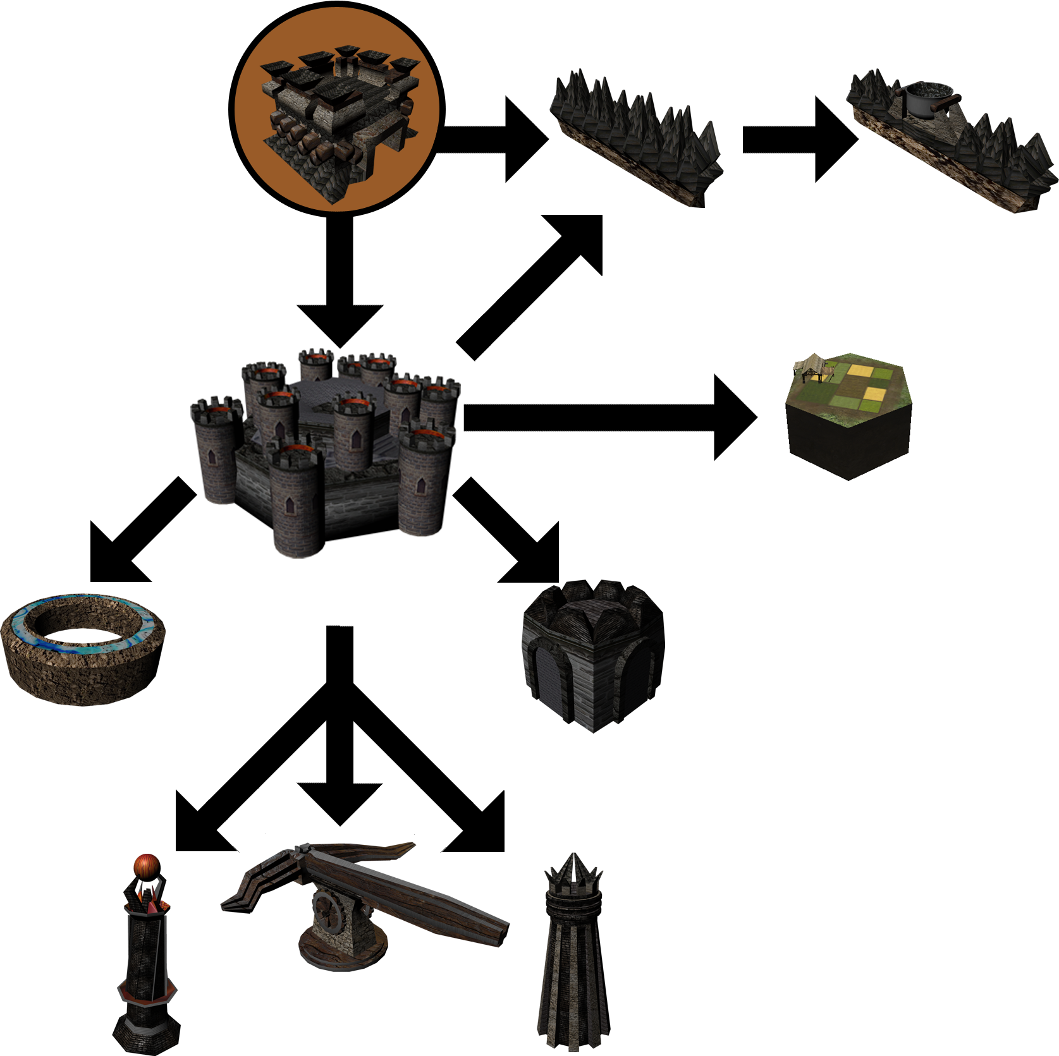
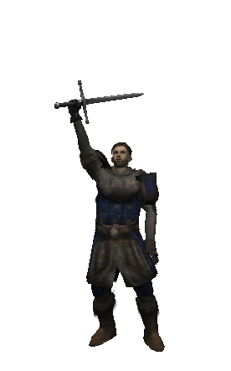
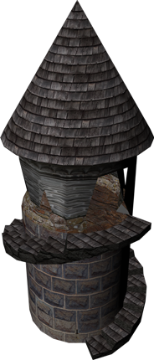
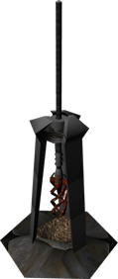
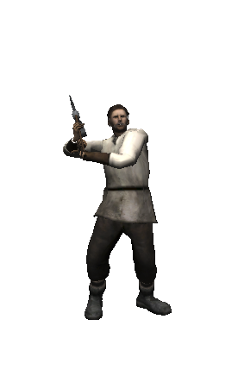
Realm of Kaodith
Gameplay
Heroes
Champion: A defensive hero built to withstand the strongest of foes.
Highmage: A master of spells capable of moving heaven and earth.
Bloodmage: A powerful magic user that spends his own life to destroy his enemies.
Marauder: A mercenary willing to fight for your cause… for the right price.
Paladin: A defender of the light supporting allies in the heat of battle.
Ranger: A quick long ranged unit that excels at scouting and ranged combat.
Warlock: A caster that uses dark magic to impede the enemy.
Citizens
Conscript: A nearby civilian forced recruited into battle. Not strong, but very cheap.
Worker: A citizen whose strength lies in building and repairing structures, as well as capturing mines.
Overview
Winning conditions
Destroy the enemy fortress before the enemy destroys yours. That’s it! You don’t need to have more gold, destroy all of their units, or have the largest army (though it may help). Simply use the units and structures outlined here to annihilate their fortress while protecting your own.
Structures
The structures in Realm of Kaodith come in 2 varieties: Fortress Upgrades and Standing Structures. Fortress upgrades are built by the player’s fortress and can only be built when certain requirements are met. Standing structures are built by the worker unit, and can be placed on any open tile that is not within range of another standing structure.
Unit Actions – Cost Ability Points (AP)
 | Move | Instruct a unit to move to a specified tile. Moving from tile to tile costs 1 AP each.
 | Basic Attack | Command the unit to attack the enemy. Damage is based on unit attack damage.
 | Defend | Tell the unit to defend. This benefits the unit depending on their class. Moving exits defend.
 | Recover | Direct the unit to recover. This heals the unit each turn. Moving, attacking or being attacked exits recover.
 | Cast | Call on the unit to use one of their four unique spells.
Fortress | Your main base. Used to build units. If you lose this you lose the game.
Citadel | An upgrade for the fortress. Increases the fortress health and unlocks further upgrades.
Siege Wall | Prevents movement between two tiles.
Boiling Oil | Upgrade a wall with boiling oil. Can be used once to damage and enemy in the adjacent tile.
Moat | Forces enemies to use more ability points to enter and leave the tiles adjacent to the fortress
Barracks | Provides extra experience to newly trained units. Units start at level 2.
Farm | Increases the number of units you can have at once.
Giant Ballista | Citadel upgrade. Can target and attack nearby enemies for a large amount of damage.
Aetherial Tower | Citadel upgrade. All units’ mana regeneration is increased.
Great Watch Tower | Citadel upgrade. Greatly increases sight range around your citadel.
Monument | Increasing the attack damage of nearby allies.
Sentry Tower | Fires at all nearby enemies each turn.
Mine | Captured by workers. Increases the gold gained per turn.
Fortress Upgrade Tree
Fortress
Siege Wall
Boiling Oil
Farm
Citadel
Moat
Sentry Tower
Barracks
Giant Ballista
Mine
Great Watch Tower
Aetherial Tower
Monument
Team DriPSaP
Andrew Buelow
Mario Carneiro
Kyle Donovan
Sam Gutentag
Stephen Hara
Computer Science and Engineering – The Ohio State University

